Slide 1


y
p
o
t
i
f
S
Kira Schwarz (stu239918)
Anahita Mesgarzadeh Tehrani (stu239550) Sahand Hamed (stu242021) Armando Criscuolo (stu231434)
Data Science Project WS24/25 Final Week 4

Slide 2
Overview
Approach
Final Questions
Visualizations
Challenges
Website
Questions

Slide 3
Approach
Finalized Questions
Looked Sources
Gathered Data
Filtered Data
Visualizations

Slide 4
Final Questions
How many users worldwide use Spotify monthly, and how has this number changed over time?
What does the sentiment analysis of news articles about Spotify reveal about the relationship between media coverage and stock performance?
Which global regions show the highest Spotify streaming activity, and how has this changed over time?
How does the ratio of free users (Free with ads) to premium subscribers impact Spotify’s revenue?

Slide 5
Final Questions
How do price changes affect Spotify's growth?
⁠Is there a tendency for popular tracks (Track Table) to appear more frequently in playlists (Playlist-Track Table)?
What demographic factors (e.g., age, gender) influence Spotify’s user base and subscription trends?
How do the popular music charts in general compare to the popular Spotify music charts?

Slide 6
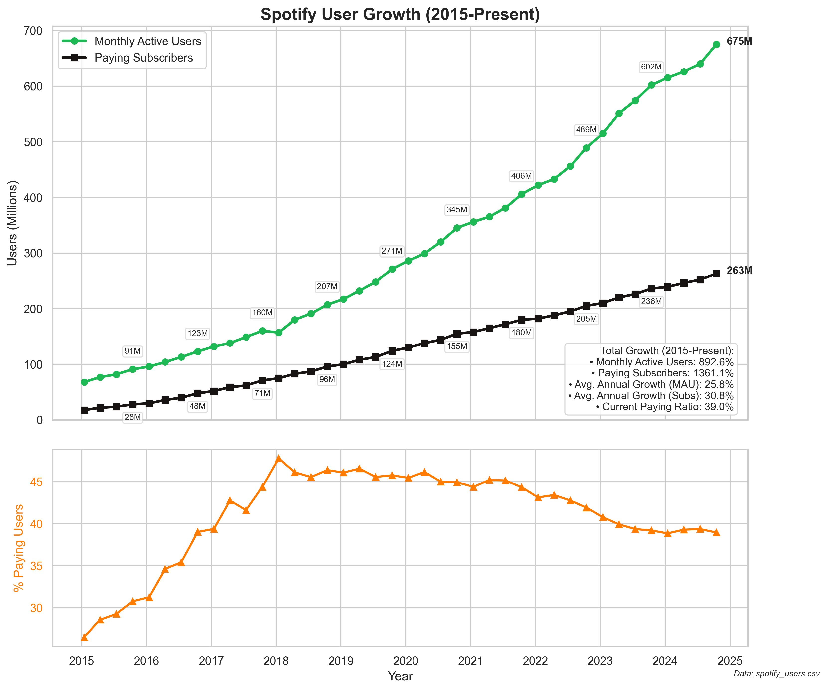
RQ 1: User Growth

Slide 7
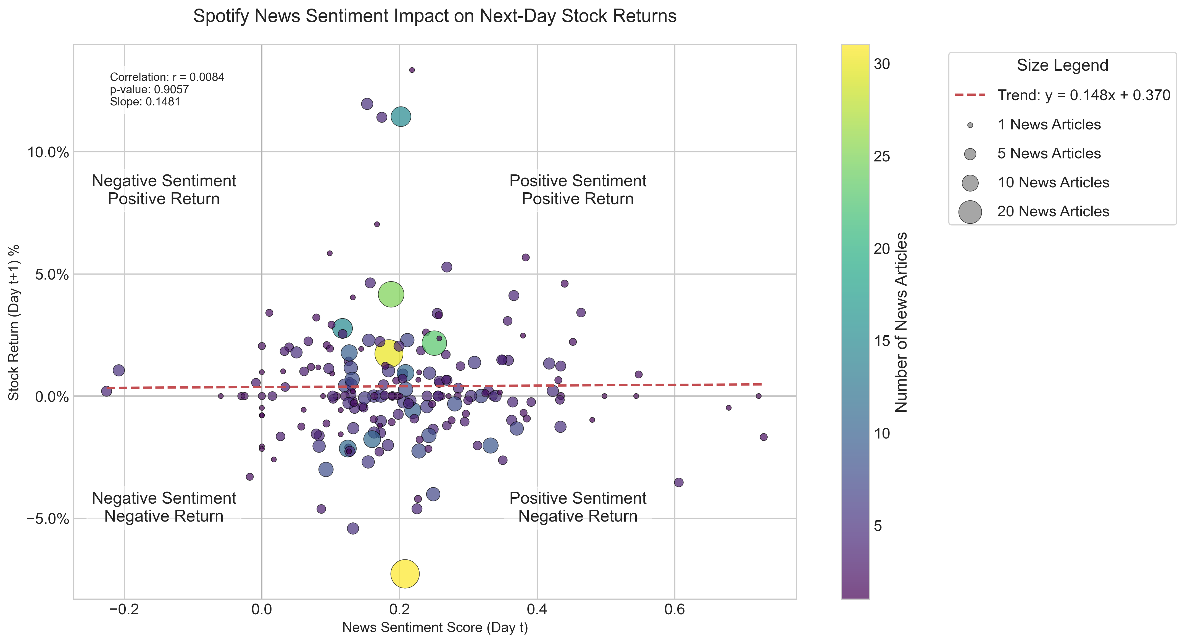
RQ 2: Media Sentiment

Slide 8
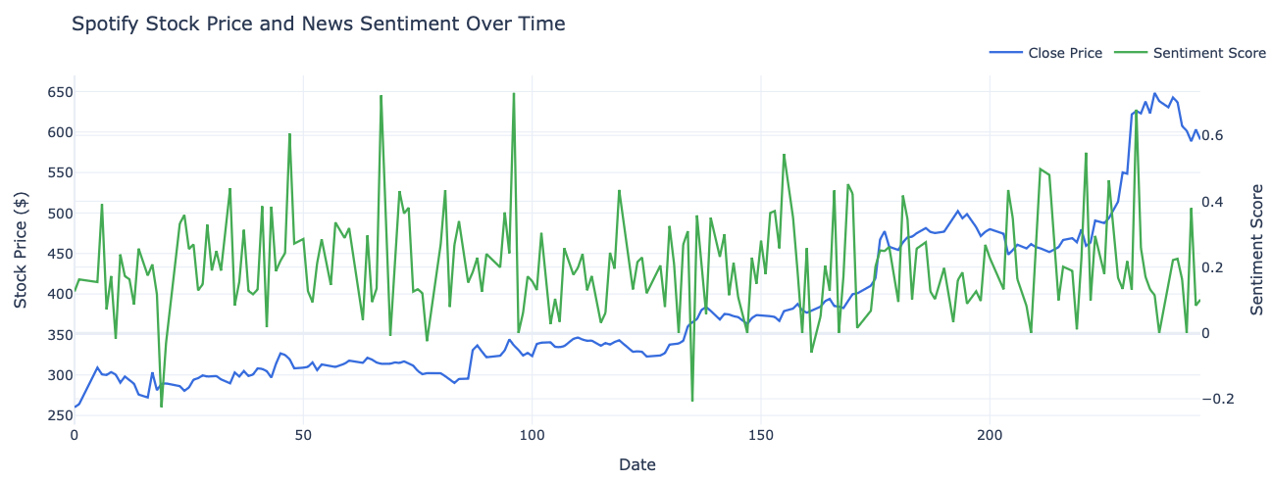
RQ 2: Media Sentiment

Slide 9
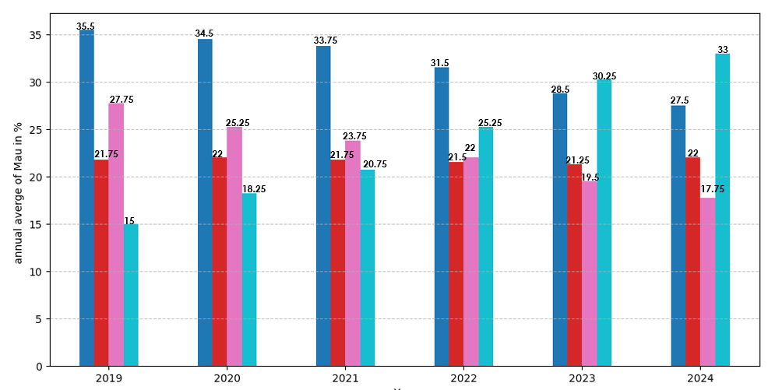
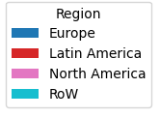
RQ 3: Regional Activity
Highest MAU: Europe & Rest of the World
Close competitors: North & Latin America

Slide 10
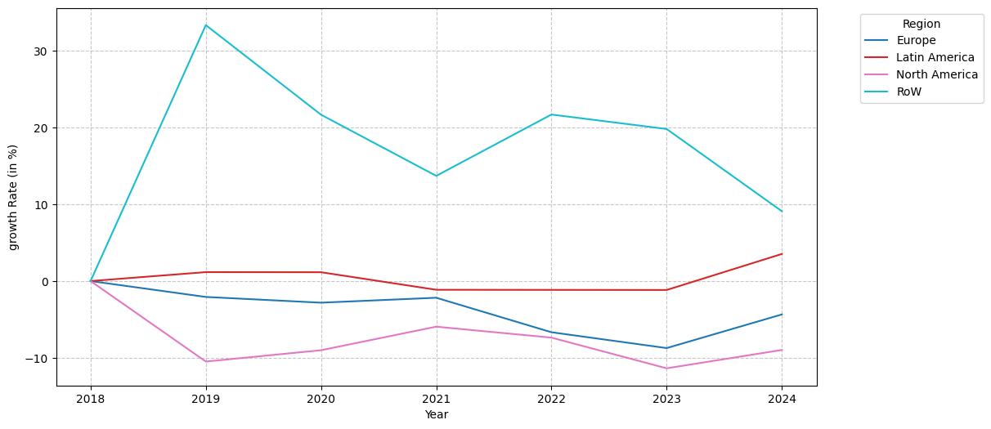
RQ 3: Regional Activity

Slide 11
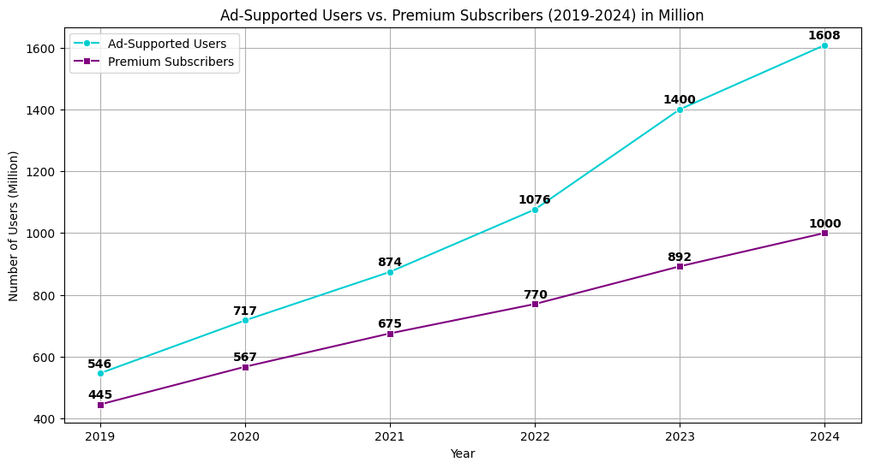
RQ 4: Free vs. Premium
Steady rise
Challenge
Covid-19

Slide 12
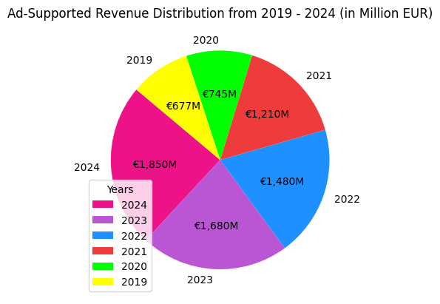
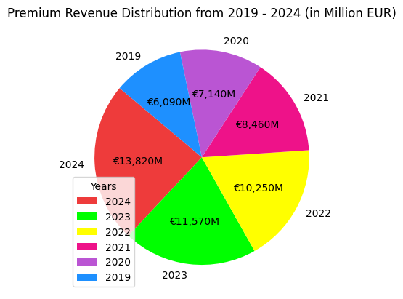
RQ 4: Revenues

Slide 13
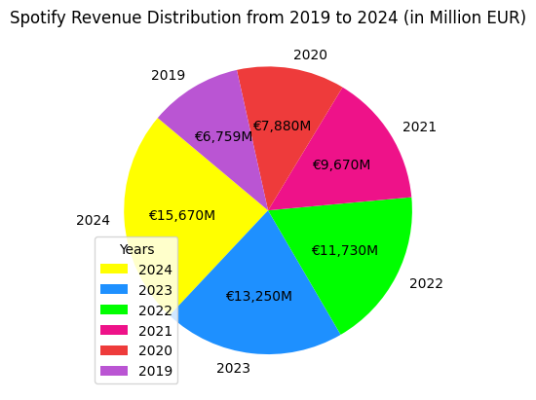
RQ 4: Revenues

Slide 14
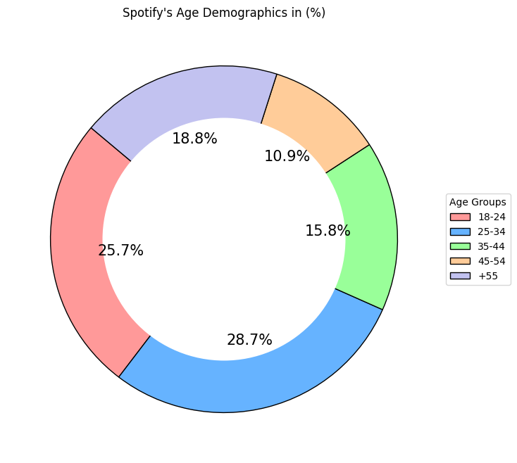
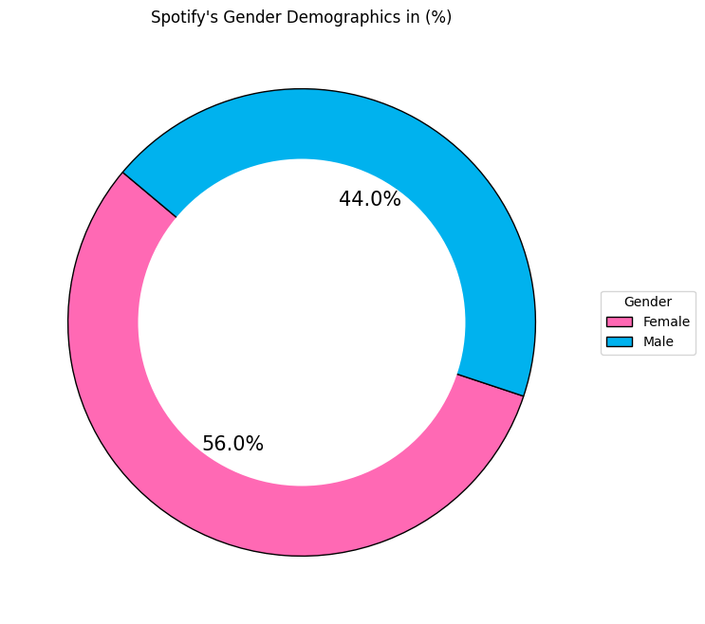
RQ 5: Demographics
Sources: 3rd Party Website**

Slide 15
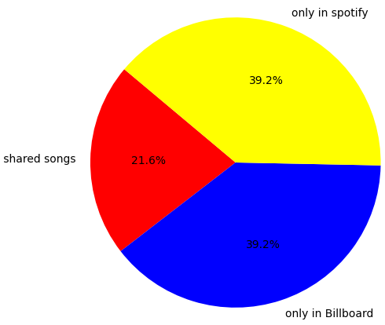
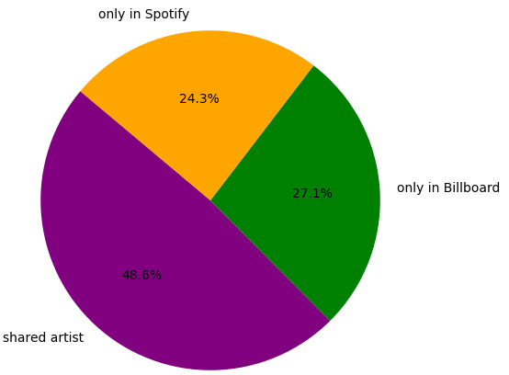
RQ 6: Chart Comparison
Percentage of Songs with the same rank: 35.50%
Average placement difference: 30.41
Correlation (Website)

Slide 16
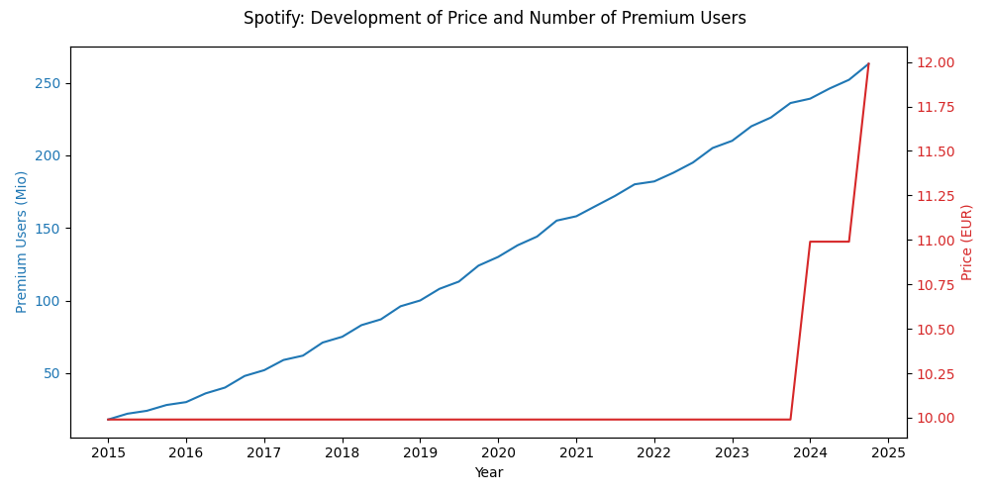
RQ 7: Price Impact

Slide 17
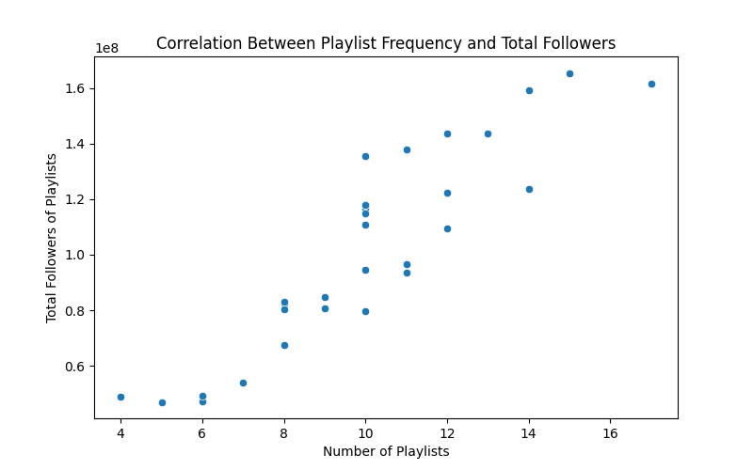
RQ 8: Track Popularity
Pearson correlation coefficient = 0.91

Slide 18

Website
Spotify Insights

Slide 19

Sources
Web API | Spotify for Developers
Spotify – Financials
Spotify Charts - Spotify Charts are made by fans
Spotify Stats | Users, Revenue & Demographics 2025 | Priori Data **
AnahitaTehrani/Data-Science-Project (GitHub)

Slide 20
Challenges
Sources
Visualization
RQ
Data

Slide 21

THANK YOU FOR LISTENING!

